Slide 1
DLS Innovation
Naniwa
February 2024
Nathaniel Dziuba

Slide 2
Contents
Innovation goals.
What is DLS and how does it work.
Integra Comparison: Manual vs Automated (Colorimetric Test)
DLS Data Analysis
DLS Runs
a. Initial integra run for feasibility and optimal standard (e.g., beads) dilution range

Slide 3
Innovation Development Goals
Develop a method to determine optimal concentration range of samples.
Automate sample pipetting and serial dilution with Integra Assist Plus.
Automate data analysis to screen sample dilutions.

Slide 4
Innovation Development Goals: Continued
The purpose of this development is to create a process that can be used on any sample with an unknown concentration. This method could be used to determine the optimal sample concentration range for DLS.
The Integra Assist Plus platform is used to automate sample preparation and plate preparation.
A template generator is used to assist in programming the DLS software for analysis.
Output DLS data is screened using a python script to determine which dilutions generate a near linear relationship in normalized intensity measurements.
The user will be required to take the screened sample list and confirm the integrity of the data by review of the auto-correlation function.

Slide 5
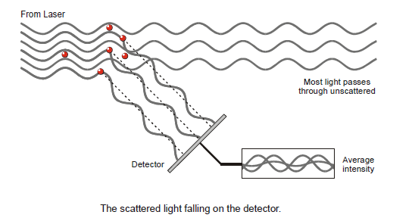
DLS Background
Particles in solution scatter light
In DLS the intensity of scattered light is measured as a function of time
Variations in scattered light are due to Brownian motion of particles
Intensity vs time plots are analyzed with an autocorrelation function

Slide 6
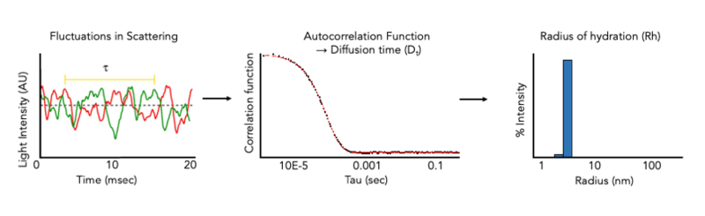
DLS Background
Auto-Correlation Function:
Measures the degree of similarity in time series data
Data at t=0 is compared incrementally to data farther away.
Data close to the start of the time series are similar (high correlation) and as we increase in time away from the start the correlation decreases
The auto-correlation function is then fit with different models:
Cumulant fits are for monodisperse distributions
Regularization fits are for polydisperse distributions and multimodal species

Slide 7
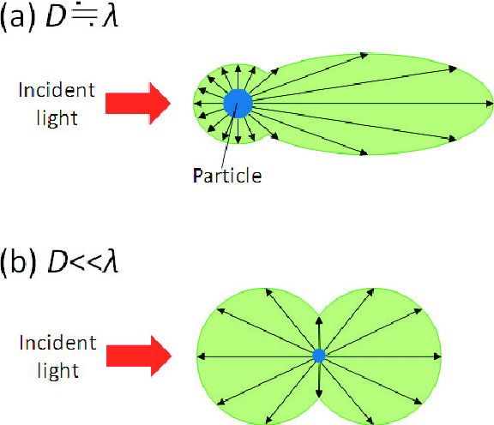
DLS: Required Sample Conditions
Scattered light is proportional to the weight-average molar mass and the molecule concentration
LS ~ M_{w}·c
For this to be true a few assumptions are made:
1) There is enough material to scatter light
2) The analyte has a size smaller than the wavelength of light used for scattering.
If it isn’t then the Mie scattering occurs.
3) The concentration of analyte does not produce multi-scattering
Scattered light is scattered again off other particles leading to larger observed average intensities
Sample Criteria:
Nearly clear
No particulates or sedimentation (centrifuge before use)
Operate with known concentrations or perform serial dilution experiment
Rule-of-thumb is 1-10 mg/mL as a place to start

Slide 8
Integra Assist Plus

Slide 9
Integra Manual Vs Automatic
The development goal was to generate a method that could perform a 2-fold serial dilution 7-times in triplicate on a 384 well plate. This would allow for a total of 16 samples on a full plate or 8 samples for half a plate.
The integra assist plus was run multiple times with a simple colometric reagents (i.e., red food colring, SoloVPE calibrant) to determine if the robotic platform functioned correctly.
Red food coloring was used initially for the first few development runs but was later replaced with SoloVPE calibrant due to the dye coating the pipette tips during serial dilution.
A combination of trial and error along with white papers from the vendor were used to determine the proper settings.

Slide 10
384-Well Plate Diagram For 2-Fold Dilution Series
 | 1 | 2 | 3 | 4 | 5 | 6 | 7 | 8
A | 1:1 | 1:2 | 1:4 | 1:8 | 1:16 | 1:32 | 1:64 | 1:128
B | 1:1 | 1:2 | 1:4 | 1:8 | 1:16 | 1:32 | 1:64 | 1:128
C | 1:1 | 1:2 | 1:4 | 1:8 | 1:16 | 1:32 | 1:64 | 1:128
D | 1:1 | 1:2 | 1:4 | 1:8 | 1:16 | 1:32 | 1:64 | 1:128
E | 1:1 | 1:2 | 1:4 | 1:8 | 1:16 | 1:32 | 1:64 | 1:128
F | 1:1 | 1:2 | 1:4 | 1:8 | 1:16 | 1:32 | 1:64 | 1:128
G | 1:1 | 1:2 | 1:4 | 1:8 | 1:16 | 1:32 | 1:64 | 1:128
H | 1:1 | 1:2 | 1:4 | 1:8 | 1:16 | 1:32 | 1:64 | 1:128
 | 1 | 2 | 3 | 4 | 5 | 6 | 7 | 8
A | 44 µL Sample | 22 µL Diluent | 22 µL Diluent | 22 µL Diluent | 22 µL Diluent | 22 µL Diluent | 22 µL Diluent | 22 µL Diluent
B | 44 µL Sample | 22 µL Diluent | 22 µL Diluent | 22 µL Diluent | 22 µL Diluent | 22 µL Diluent | 22 µL Diluent | 22 µL Diluent
C | 44 µL Sample | 22 µL Diluent | 22 µL Diluent | 22 µL Diluent | 22 µL Diluent | 22 µL Diluent | 22 µL Diluent | 22 µL Diluent
D | 44 µL Sample | 22 µL Diluent | 22 µL Diluent | 22 µL Diluent | 22 µL Diluent | 22 µL Diluent | 22 µL Diluent | 22 µL Diluent
E | 44 µL Sample | 22 µL Diluent | 22 µL Diluent | 22 µL Diluent | 22 µL Diluent | 22 µL Diluent | 22 µL Diluent | 22 µL Diluent
F | 44 µL Sample | 22 µL Diluent | 22 µL Diluent | 22 µL Diluent | 22 µL Diluent | 22 µL Diluent | 22 µL Diluent | 22 µL Diluent
G | 44 µL Sample | 22 µL Diluent | 22 µL Diluent | 22 µL Diluent | 22 µL Diluent | 22 µL Diluent | 22 µL Diluent | 22 µL Diluent
H | 44 µL Sample | 22 µL Diluent | 22 µL Diluent | 22 µL Diluent | 22 µL Diluent | 22 µL Diluent | 22 µL Diluent | 22 µL Diluent

Slide 11
Integra Assist Plus
Experimental Parameters for Integra Assist Plus that were used form comparison to manual
Integra 08 indicates experiment 8 with integra, experiment 9 was manual.
Parameter | Integra 08 | Integra 10
Asp. Disp. Speed | 7 | 6
Mix Vol. | 20 | 15
Liquid Entry/Exit | Normal | Slow
Mix Speed | 7 | 6
SD Source Target | 4.1 mm | 4.8 mm
Pre-Wetting SD | No | No
Air Bubbles Observed? | Yes | No
Blow Out | Yes | Yes

Slide 12
Integra vs Manual Pipetting Using Dye: Linearity

Slide 13
Calculated Dilution Factor: Bar Chart with CI Error Bars

Slide 14
Calculated Dilution Factor Statistical Significance
Step 6 & 7 are near the limit of the detector.
Step 2 mean + CI = 2.6.
Will use as the limit in data processing.
Dilution step 4 and 6 show significant difference in mean calculated dilution factor in a paired t-test, p<0.05.

Slide 15
DLS Data Analysis Flow Chart

Slide 16
Running Sample With Plate Templates in Dynamics: Flow Chart

Slide 17
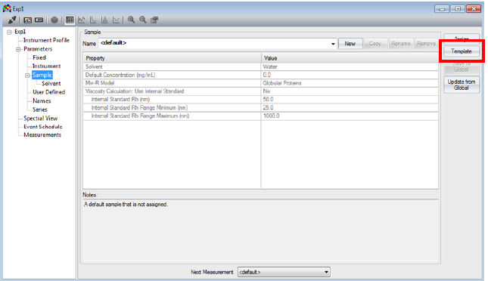
Dynamics Software Example: Sample
Prepopulate samples 1-12 in the software for future use.
Sample parameters should be reviewed prior to running the experiment.
If the wrong information is input, the data is reprocessed, no reruns required.

Slide 18
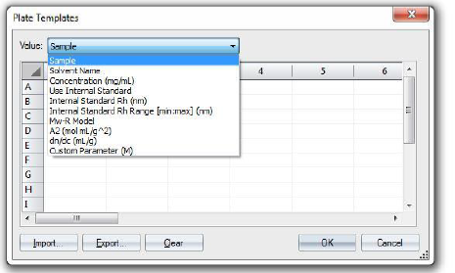
Dynamics Software Example: Plate Template

Slide 19
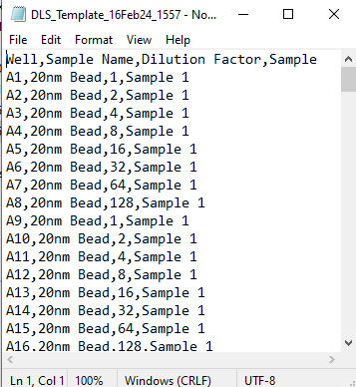
Template Example
Samples can be loaded in a CSV file in the software to assign a well with various parameters: Well position, Sample Name, Dilution Factor, Sample.

Slide 20
DLS Data Processing

Slide 21
Data Processing

Slide 22
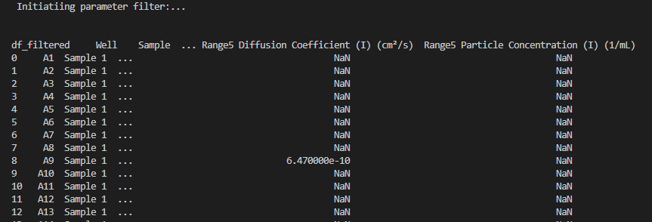
DLS Data Analysis
Initialization of the data frame (think excel) with basic column header filtering

Slide 23
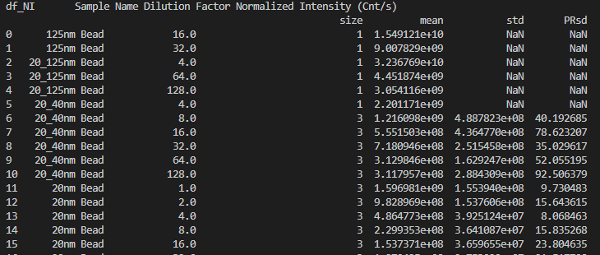
DLS Data Analysis
Each measurement is filtered for Baseline, SOS, Amplitude, and # of marked acquisitions
The data is then grouped by Sample Name and Dilution Factor for Normalized Intensity

Slide 24
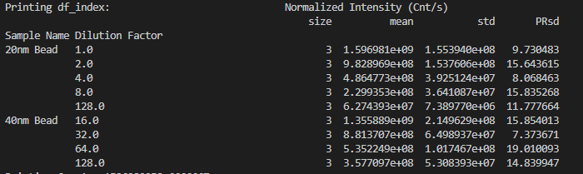
DLS Data Analysis
- Results are filtered for a Dilution Factor fold-difference of 2 and for the normalized intensity mean fold-difference to equal 2 ± 30%

Slide 25
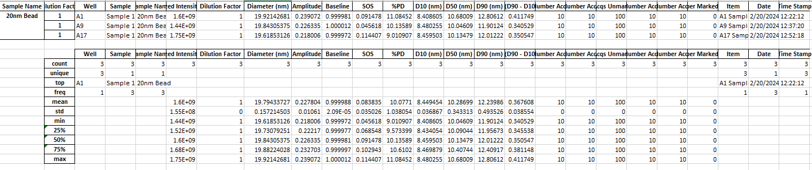
Excel Export
Data that fit the criteria described above are exported into an excel workbook within the working directory.
All data presented in the

